Slide 1

EXPLORATORY DATA ANALYSIS OF UNICORN COMPANIES
BY ADEFEMI ADEGBITE

Slide 2
ABOUT UNICORNS
Unicorn companies are privately held startup companies that have achieved a valuation of $1 billion or more. The term "unicorn" is used to describe these startups because they are considered rare and mythical due to their exceptional growth and valuation. Unicorns are typically technology-based firms that disrupt traditional industries or create entirely new markets. They often attract significant attention from investors, media, and the business world due to their potential for high returns.
These companies are known for their rapid growth, innovative business models, and disruptive technologies. The term "unicorn" was popularized in the venture capital industry to denote startups with the potential for extraordinary success and value creation. Unicorns are often closely watched as they represent the cutting edge of innovation and have the potential to transform industries and economies.

Slide 3
OVERVIEW….
The data used in this analysis includes statistics related to 1,074 companies, specifically their valuation, date of joining, year of founding, funding received, ROI (Return on Investment), industry, city, country, investors. These statistics offer insights into the world of startups and unicorn companies. Python was used this analysis.

Slide 4
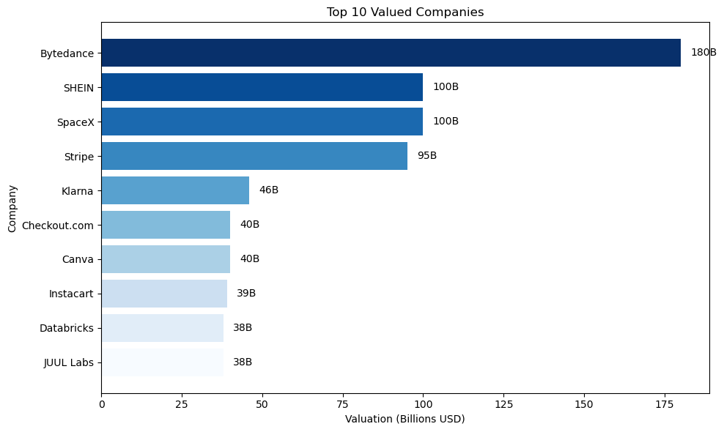
Valuation Distribution
The distribution of valuations in the dataset shows that most companies have valuations below $10 billion, with the majority falling in the $1 billion to $3 billion range.
There are a few exceptional cases with valuations exceeding $10 billion, including one with a valuation of $180 billion. These outliers represent companies with extraordinary growth.
The company "Bytedance" has the highest valuation, with a valuation of $180 billion.
"SpaceX" and "SHEIN" are tied for the second-highest valuation, both valued at $100 billion.

Slide 5
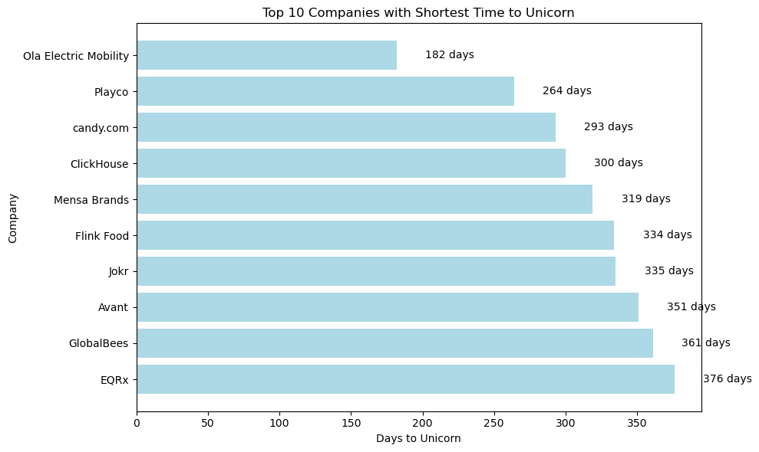
Time to Unicorn
The “Time to Unicorn” metrics demonstrate that while some companies achieve unicorn status relatively quickly, others take several years. This reflects the variability in the time it takes for startups to grow and attract significant investment.
"Ola Electric Mobility" achieved unicorn status in the fastest time, taking only 182 days to do so.
"Playco" reached unicorn status in 264 days, making it the second-fastest company in the list.
"candy.com" achieved unicorn status in 293 days, securing the third spot in terms of speed.

Slide 6
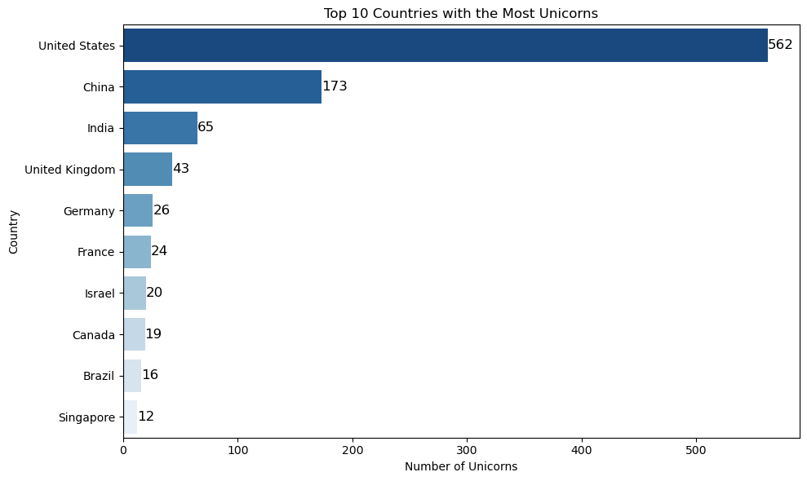
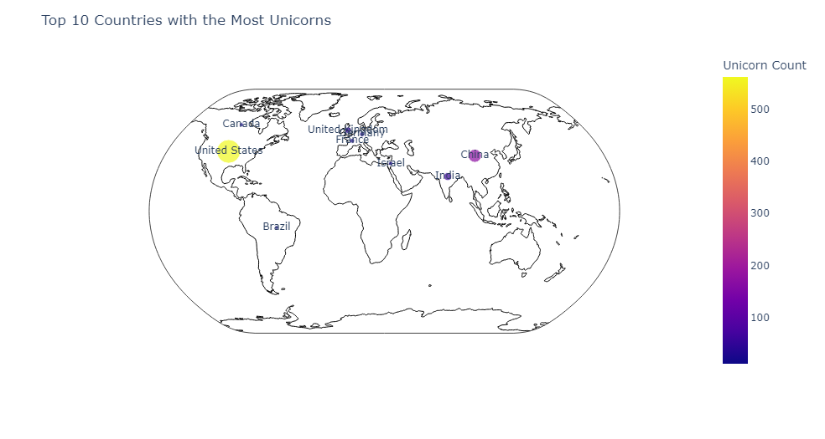
Top Unicorn Countries
The United States has the highest number of unicorn companies, with 562 unicorns.
China is the second country with the most unicorn companies, boasting 173 unicorns.
India follows with 65 unicorn companies.

Slide 7
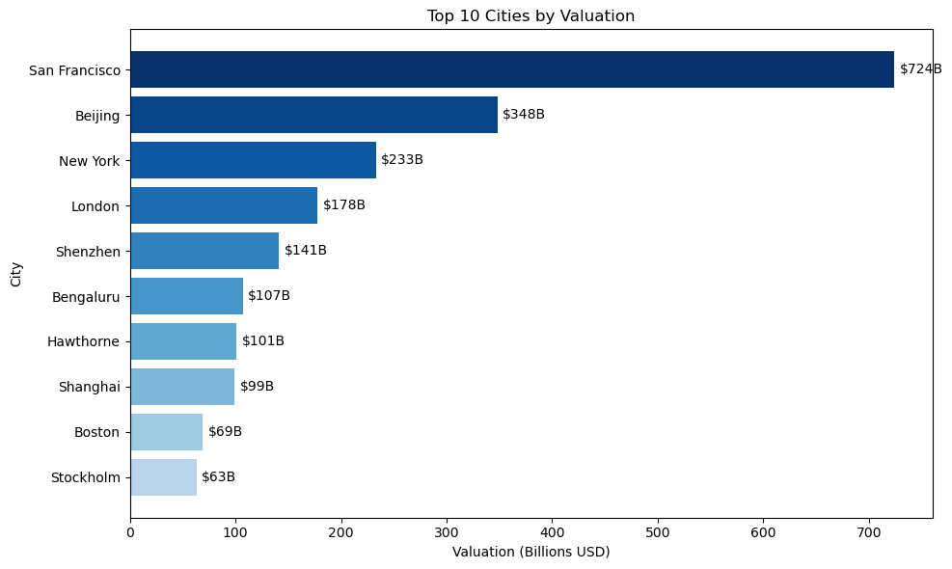
Top Unicorn City
San Francisco Dominance: San Francisco is the leading city by unicorn company valuation, significantly outpacing other cities. This indicates the strong presence of high-valuation tech companies in Silicon Valley.
Global Economic Hubs: Beijing, New York, and London follow, showcasing their prominence as major global economic and financial centers.
Emerging Tech Hubs: Cities like Shanghai, Shenzhen, and Bengaluru are emerging as strong contenders in the technology and innovation space, as reflected by their notable unicorn valuations.
Geographic Diversity: The chart demonstrates that unicorn companies are not confined to a single geographic location; they are distributed across various regions worldwide.

Slide 8
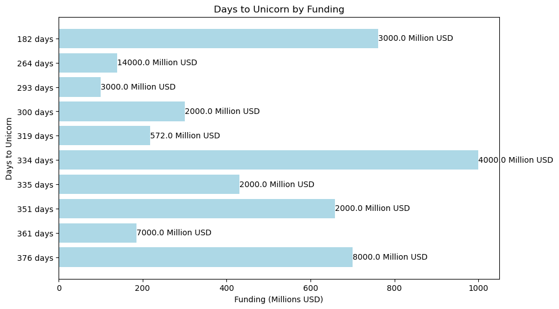
Funding Impact on Time to Unicorn
No Clear Correlation: There doesn't appear to be a straightforward correlation between the time it takes a company to become a unicorn and the amount of funding it secures. Some companies achieved unicorn status relatively quickly with significant funding, while others took longer and secured substantial investments.

Slide 9
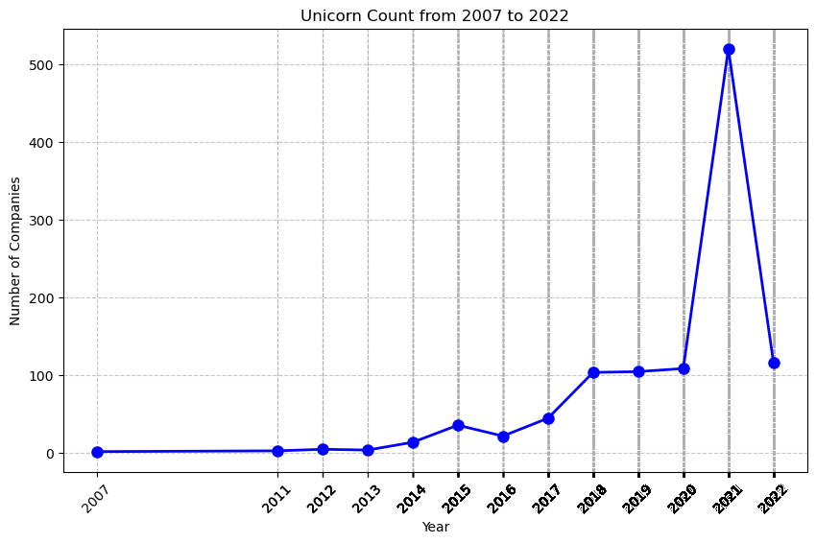
Unicorn Yearly Count
Yearly Growth: The line graph illustrates a clear upward trend in the number of unicorn companies over the years. The most significant growth occurred in 2021 when the number of unicorn companies surged to 520, indicating a substantial increase in innovative startups achieving unicorn status.
Steady Growth: From 2014 onwards, there has been a consistent growth in the number of unicorn companies, suggesting a healthy and expanding startup ecosystem.
Accelerated Growth: The growth from 2018 to 2021 was particularly remarkable, with a rapid increase in unicorn companies, indicating a strong period for innovation and investment in startups. 2022 dataset ended in May making it difficult to compare with 2021

Slide 10
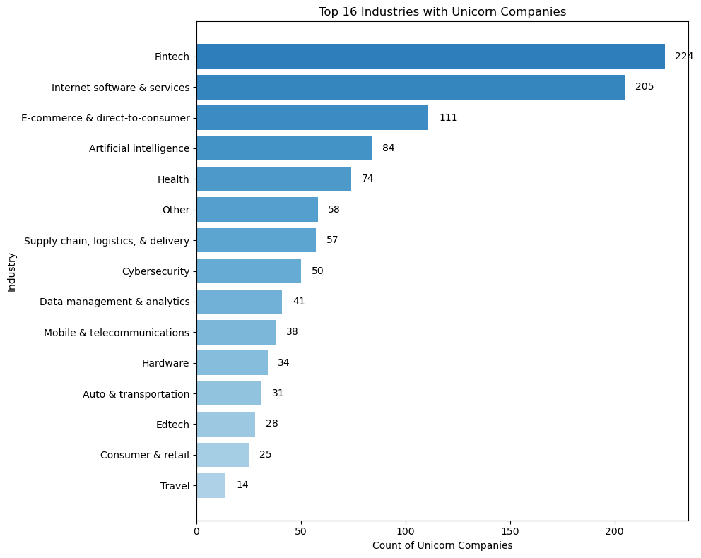
Industry Concentration
Fintech Dominance: Fintech stands out as the industry with the highest number of unicorn companies, far surpassing the other industries.
Tech-Related Industries: Several tech-related industries, including Internet software & services, Artificial intelligence, and Cybersecurity, are among the top industries with a significant presence of unicorn companies.
E-commerce: E-commerce & direct-to-consumer is a major player, but it falls behind the leading tech-related industries.
Diversity of Industries: The chart illustrates the diverse landscape of unicorn companies, including industries such as Health, Supply chain, logistics, & delivery, and Data management & analytics.

Slide 11
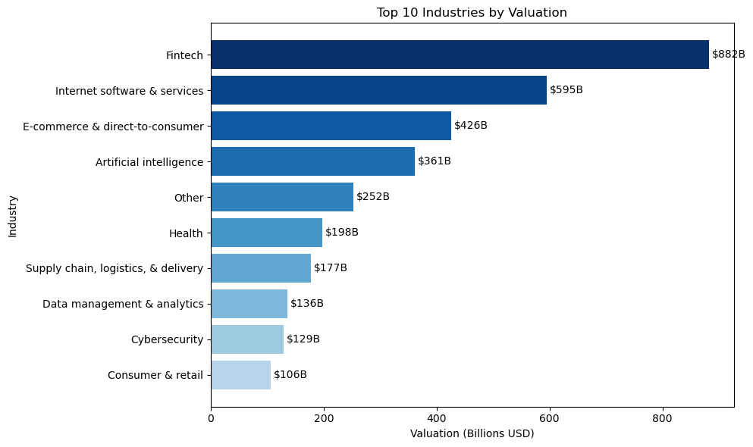
Industry by Valuation
Fintech Dominance: Fintech stands out as the industry with the highest total valuation among unicorn companies, indicating its substantial impact and significance in the financial technology sector.
Technology and Software Powerhouses: Industries related to technology, software, and artificial intelligence, including Internet software & services and Artificial intelligence, occupy top positions, emphasizing the importance of software-driven innovations and tech-related ventures.
E-commerce and Consumer Impact: E-commerce & direct-to-consumer, along with Consumer & retail, have substantial valuations, reflecting the influence of digital commerce and consumer-focused businesses.
Diverse Industry Landscape: The chart demonstrates the diversity of industries in the unicorn startup ecosystem, including sectors like Health, Supply chain, logistics, & delivery, and Data management & analytics, showcasing the versatility of the companies involved.

Slide 12
Funding vs. Valuation
A noticeable pattern is that higher valuations are generally associated with higher funding amounts. Companies with valuations above $10 billion often received substantial funding, with some even reaching $14 billion.
However, there are companies with moderate funding that have achieved valuations in the billions, indicating that efficient resource utilization and growth strategies can lead to unicorn status.

Slide 13
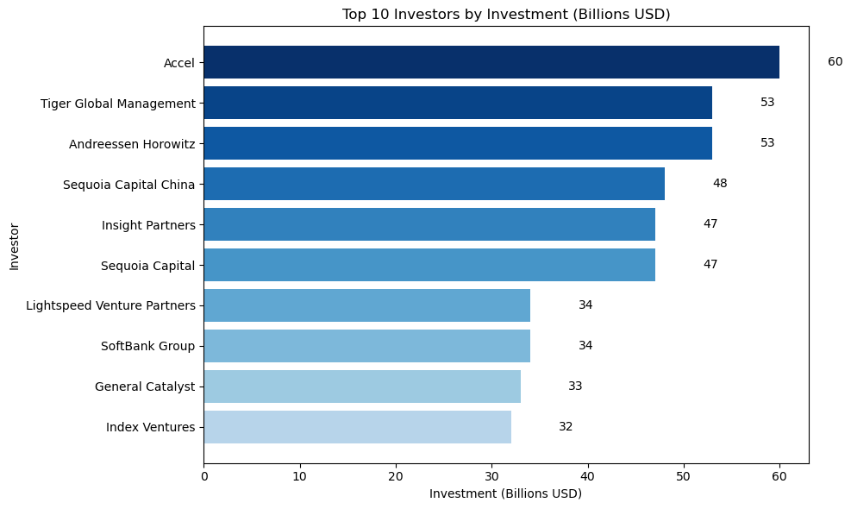
Top 10 Investors
Investment Giants: Accel, Tiger Global Management, and Andreessen Horowitz are the top investors, with the highest total investments. These investors have played a significant role in funding unicorn companies.
Prominent VC Firms: Notably, Sequoia Capital China, Insight Partners, Sequoia Capital, and Lightspeed Venture Partners are among the top investors, reflecting the significance of venture capital firms in supporting unicorn startups.

Slide 14
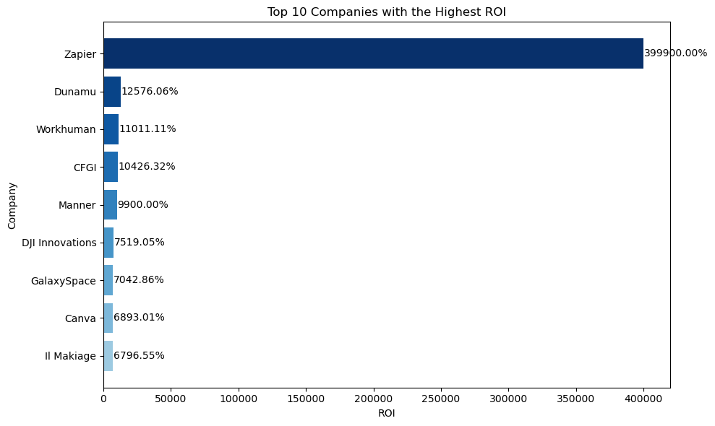
Top 10 ROI
Zapier Leads with an Astounding ROI: Zapier stands out as the company with the highest return on investment (ROI) among the top 10, with a remarkable ROI of approximately 399,900%. This suggests that for every dollar invested in Zapier, the return is nearly 4,000 times the initial investment, indicating extraordinary profitability.
Diverse Range of High ROI Companies: The chart features a diverse range of companies, from tech startups like Zapier and Dunamu to companies like Workhuman and CFGI. This diversity showcases that high ROI can be achieved in various industries and sectors.
Tech and Innovation Dominate: Technology and innovation-related companies like Zapier, DJI Innovations, GalaxySpace, and Canva prominently feature in the top 10. This highlights the impact of technology and innovation on generating high returns on investment.

Slide 15

Recommendations
Increase Funding: This analysis shows that the mean funding for these companies is around 550 million dollars. Companies that are looking to grow and achieve higher valuations may consider increasing their funding. This could be achieved through various means, such as seeking additional investments, securing venture capital, or exploring other funding sources.
Focus on Dominant Industries: Given the data, industries like Fintech and Internet Software & Services have the highest numbers of unicorn companies. Stakeholders should consider focusing their investments and efforts in these dominant industries.
Diversification: While the dominant industries are attractive, it's important to maintain a diversified investment portfolio. Explore opportunities in other industries like E-commerce & Direct-to-Consumer, Health, and Artificial Intelligence, which also have a notable presence of unicorn companies.

Slide 16

Recommendations
Optimize Year Founded: To improve revenue generation, stakeholders may consider focusing on businesses founded in recent years, as they may have more growth potential and align with current market trends.
Mergers and Acquisitions: Explore the possibility of mergers or acquisitions with unicorn companies from different years to tap into their market reach and innovative solutions. M&A strategies can be an effective way to benefit from the growth of established startups.
Investment Focus: Concentrate investments and resources on cities with the highest numbers of unicorn companies. San Francisco and New York stand out as the leading cities in this regard. Consider expanding your presence in these cities to tap into their vibrant startup ecosystems.

Slide 17
Recommendations
Market Expansion: Explore opportunities for market expansion in cities with a growing number of unicorns, such as Beijing, Shanghai, and London. These cities indicate a rising trend in entrepreneurship and innovation.
International Collaboration: Foster international collaborations and partnerships with companies and organizations based in cities like San Francisco, New York, and Beijing. These cities often serve as global business hubs and can offer valuable connections and opportunities.

Slide 18
Thank you

